Slide 1
Documentary Movies Rating over 121 years
Lama Hamadeh
To make a copy for your presentation, use “File->Download”. No need to request edit permission.

Slide 2
Dataset(s)
Which dataset did you use of the following:
Soccer Dataset
IMDB Movie Dataset
World Development Indicators Dataset

Slide 3
Motivation
Describe the problem you want to solve with the data. It may relate closely with your research question, but your goal here is to make your audience care about the project/problem you are trying to solve. You need to articulate the problem you are exploring and why (and for whom) insight would be valuable.
In this mini project, I have used the ’movies’ data base to investigate the behaviour of documentary movies over the studied years, i.e., over 120 years. By the end of this project, we can see:
The rating behaviour towards documentary movies
The production process of such movies over the years

Slide 4
Research Question(s)
What is your research question you aim to answer using the dataset? Be sure the research question is well defined (see project description for details).
How the rating behaviour changes towards documentary movies over 121 years?

Slide 5
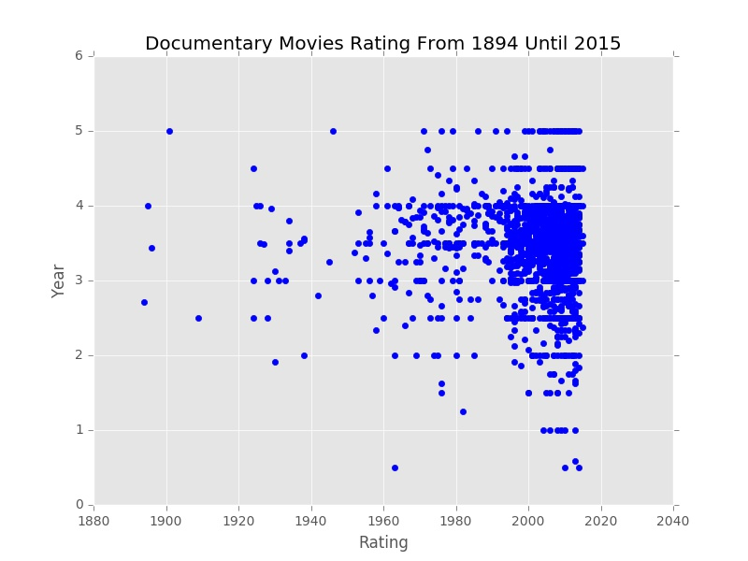
Findings
In the adjacent scatter plot, we can see how the ratings of the documentary movies changes over 121 years.
The mean ratings value of the overall documented movies is around 3.5.
Also, it can be seen that the production of documentary movies has dramatically increased starting from year 2000 onwards.

Slide 6
Acknowledgements
Did you use other informal analysis to inform your work? Did you get feedback on your work by friends or colleagues? Etc.
If you had no one give you feedback, it’s okay to say that.
I have done this work by myself. No one has given me any feedback.

Slide 7
References
If applicable, report any references you used in your work. For example, you may have used a research paper from X to help guide your analysis. You should cite that work here. If you did all the work on your own, please state this.
I have used:
https://pandas.pydata.org
https://stackoverflow.com

